Slide 1
INFO7390 – Advanced Data Sci/Architecture
Project Title : Hotel Booking Cancellation Prediction
Project Members (Team3):-
Anuja Thatte - 002107348
Shreya Iyer - 001300102
Aditya Kinare - 001095881
Kunal Desai - 002193570

Slide 2
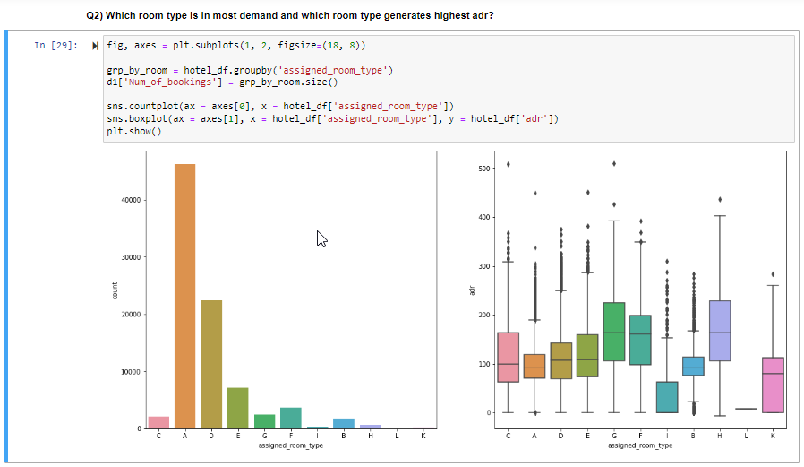
Data Visualization - Samples

Slide 3
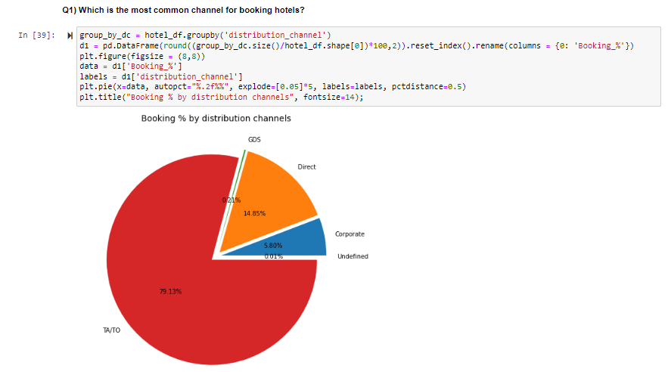
Data Visualization - Samples

Slide 4
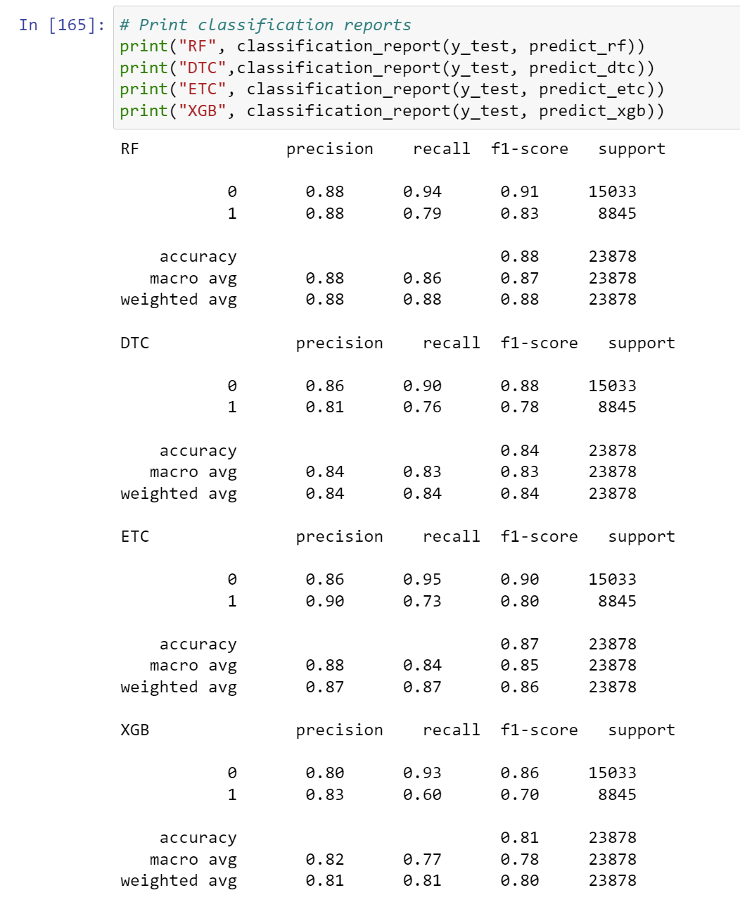

Slide 5
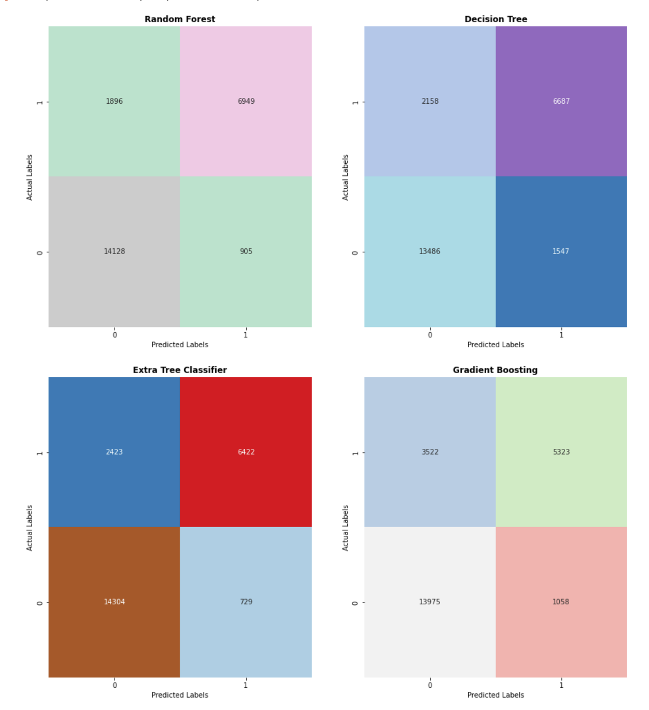

Slide 6
Thank You

